Slide 1

Artificial Neural Networks - Project
W12AIR-SM0721P
Wine quality classification using Artificial Neural Network
Presentation1
Autors in group:
Paweł Ozga
Pranav Pramod

Slide 2
Milestone
Presentation 1 (25.03.2025) Topic - Wine quality classification using ANN.
(8.04.2025/6.05.2025) Prepare code to next presentation.
Presentation 2 (20.05.2025) Multilayer prescription, function, back propagation etc.
(20.05.2-25/3.06.2025) Preprocessing set Test/Train/Validation.
Presentation 3 (17.06.2025) Project - Solution.

Slide 3
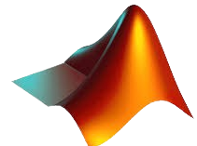

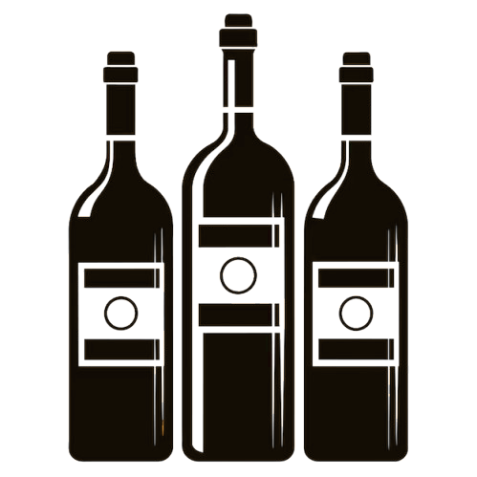
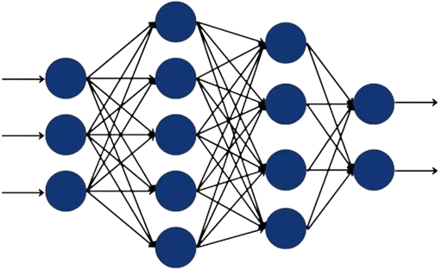
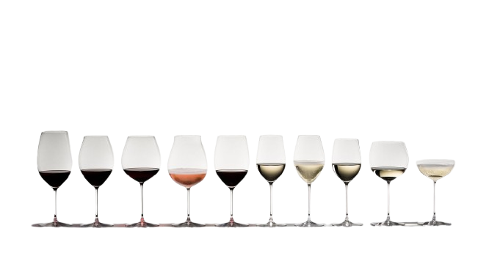
MATLAB Toolbox: Statistics and Machine Learning & Deep Learning
EXCEL Dataset : We train our model using DATASET (with numerous variables) containing various wine sample with features.
INPUT
(features)
OUTPUT
(classes)
Dateset : by Andrewmchen and Mateiz from GitHub
link: https://github.com/mlflow/mlflow-example/blob/master/wine-quality.csv

Slide 4
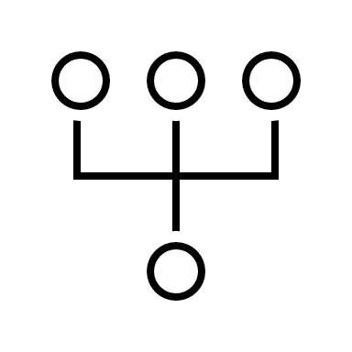


Division of responsibilities
Paweł Ozga
Pranav
Research about MLP network
Effect of Bias in Neural Network
Back propagation
Levenberg – Marquardt algorithm
Coding: both
Model Development & training
Documentation & presentation
Dataset & Handling
Coding: both
Model Development & training
Documentation
Preprocessing
Presentation
all

Slide 5

END PRESENTATION 1
Presentation1

Slide 6
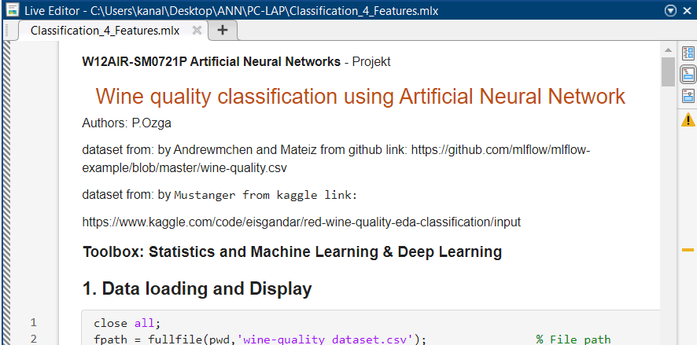
DATASET PREPARATION, BUILDING NETWORK, DISPLAYING RESULT
Presentation2
…

Slide 7
RESEARCH FOR DATABASE & SIMILAR SOLUTION
Kaggle:
🍷 Red Wine Quality ~ EDA & Classification, by Mustanger:
https://www.kaggle.com/code/eisgandar/red-wine-quality-eda-classification
Stochastic Gradient Descent, By Ryan Holbrook:
https://www.kaggle.com/code/ryanholbrook/stochastic-gradient-descent/data?select=red-wine.csv
Wine Quality, by web UC Irvine Machine Learning Repository:
https://archive.ics.uci.edu/dataset/186/wine+quality
Github:
mlflow-example/wine-quality.csv, by Andrewmchen and Mateiz:
https://github.com/mlflow/mlflow-example/blob/master/wine-quality.csv
Red-Wine-Quality/winequality-red.csv, by aniruddhachoudhury:
https://github.com/aniruddhachoudhury/Red-Wine-Quality/blob/master/winequality-red.csv
EDA-ML/Wine/winequality_red.csv, by JakubPluta:
https://github.com/JakubPluta/EDA-ML/blob/master/Wine/winequality_red.csv

Slide 8
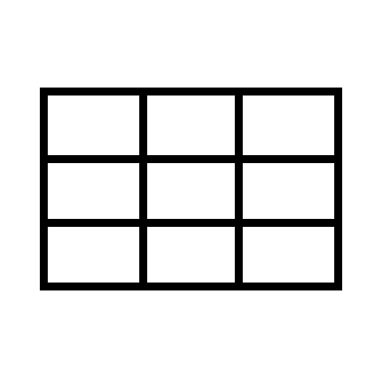


ARCHITECTURE OF CODE: MATLAB
RESULT
Prediction and Evaluation,
Acuracy,
Confusion Matrix:
BUILD & TEST
Data Splitting,
MLP network:
DATASET
Data loading and Display,
Data Verification,
Dataset Statistics Calculation,
Sample Selection,
Class Distribution,
Normalization input,
Label Encoding (One-hot Encoding)
…
…
Input: One feature for one neuron
Output: quality class (3-LOW ,9-HIGH)
1-hidden layer of linear dependencies
2-hidden layer of nonlinear dependencies

Slide 9
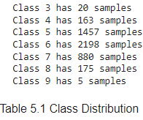
DATASET PREPARING
Raw Dataset: number of samples matters! Because in this set:
The neural network overfits the training data.
Classes 3 and 9 are ignored, and Class 6 dominates the dataset.
REMEDIES:
Oversampling:
- SMOTE creates synthetic samples of the minority class,
- Random Oversampling duplicates existing minority samples,
- Risk of overfiting,
- Balances class distribution
Undersampling:
- Removed dominant classes,
- Fastes training,
- Possible loss of important information
Manual/Define class weights
- Assign higher importance to minority classes in the loss
function
- Defining with class is important than else
- Selected samples are always in the training set

Slide 10
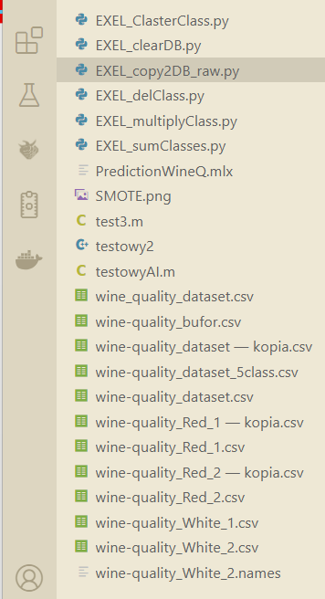
DATASET PROPOSAL FOR MODIFICATION OF INPUT DATA
OPERATIONS ON THE DATASET:
Oversampling, Upsampling, Copying to the database, Class multiplication / Replication of classes, Summation of samples within classes
TESTED DIFFERENT METHOD
DATASET:
Compared the dataset from Kaggle & github
Check different dataset Red Wine -> White Wine
Saved backup for each dataset

Slide 11
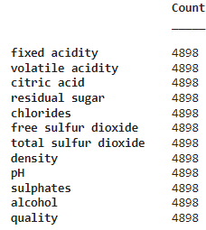
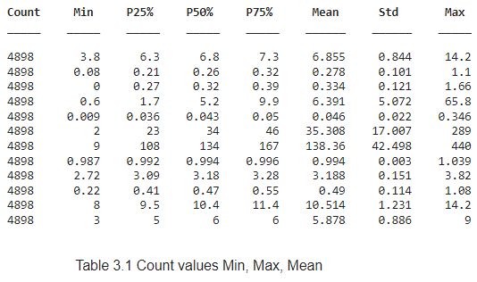

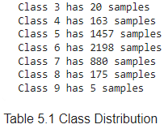
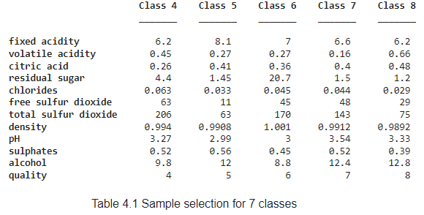

DATASET Statistics Calculation
MIX method
Added 3 -> 4
Added 9 -> 8
Undersampling class 5,6

Slide 12



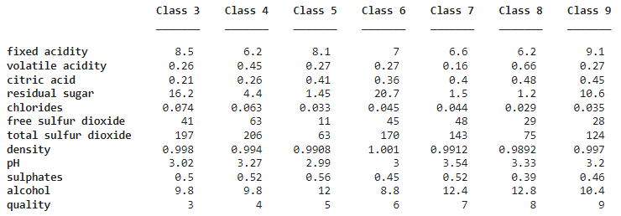
DATASET AVERAGE OF SAMPLES FOR EACH CLASS
most significant feature
less important feature
Wine score
Class 3:
Class 4:
Class 5:
Class 6:
Class 7:
Class 8:
Class 9:
fixed acidity (8.5) ↑ , Residual sugar (16.2) ↑
free sulfur dioxide (63) ↑, total sulfur dioxide (20.6) ↑, pH (3.27) ↑
alcohol (12) ↑, chlorides (0.033) ↓, density (0.9908) ↓
residual sugar (20.7) ↑ , alcohol (8.8) ↓, density (1.001) ↑
alcohol () ↑, pH (3.54) ↑, volatile acidity (0.16) ↓
sulphates (0.39) ↓, density (0.9892) ↓ , alcohol (12.8) ↑
fixed acidity (9.1) ↑, citric acid (0.45) ↑, residual sugar (10.6) ↑
Is every feature important?
RESEARCH/
knowledge building

Slide 13
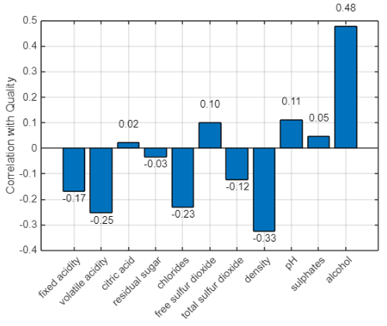
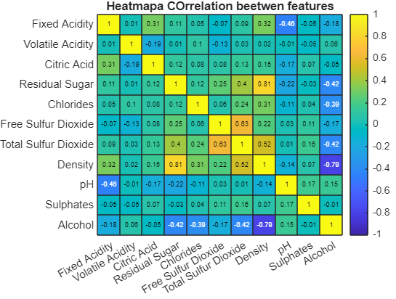
DATASET CORRELATION FOR FEATURES
The only minor difference is the weaker impact of sulphates compared to the earlier data, but it is still positive.
✅ Alcohol ➕ More alcohol = better quality
✅ Citric acid ➕ Slightly improves quality
✅ Sulphates ➕ Mild positive impact
❌ Density ➖ Strongly lowers quality
❌ Volatile acidity ➖ Reduces quality
❌ Chlorides ➖ Negative effect on quality

Slide 15
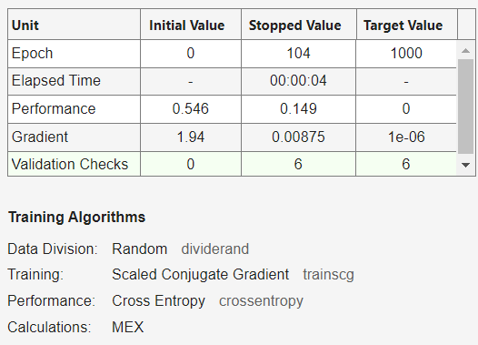
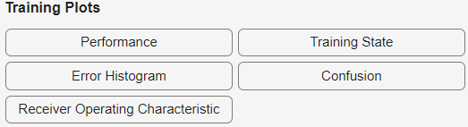
BUILDING & TEST DATA SPLITTING
MATLAB R2024b
toolbox:
Statistics and Machine
Learning & Deep Learning
FUNCTION:
%cv = cvpartition(Y_categorical, 'KFold', 5, 'Stratify', true);
cv = cvpartition(Y_cat,'Holdout',0.2);
X_train = X(training(cv),:);
Y_train = Y_encoded(training(cv),:);
X_test = X(test(cv), :);
Y_test =Y_encoded(test(cv), :);
net = patternnet([10, 5]);
net.trainFcn = 'trainscg’;
net.layers{end}.transferFcn = 'softmax’;
net.performFcn = 'crossentropy’;
net.trainParam.showWindow = false;
[net, tr] = train(net, X_train',Y_train');
1. SPLITING
2. ARCHITECTURE
3. TRAINING PROCESS
4. TRAINING PLOTS
CONFUSION MATRIX

Slide 16
%cv = cvpartition(Y_categorical, 'KFold', 5, 'Stratify', true);
cv = cvpartition(Y_cat,'Holdout',0.2);
X_train = X(training(cv),:);
Y_train = Y_encoded(training(cv),:);
X_test = X(test(cv), :);
Y_test =Y_encoded(test(cv), :);
BUILDING & TEST USED TOOLBOX
COMPARE FUNCTION FROM Statistics and Machine Learning and own function
Same result, but wider access to parameters
validClasses = unique(Y);
trainIdx = [];
testIdx = [];
holdoutRatio = 0.2;
for i = 1:length(validClasses)
classValue = validClasses(i);
classIndices = find(Y == classValue);
classIndices = classIndices(randperm(length(classIndices)));
numTest = round(holdoutRatio * length(classIndices));
testIdx = [testIdx; classIndices(1:numTest)];
trainIdx = [trainIdx; classIndices(numTest+1:end)];
end
X_train = X(trainIdx, :);
Y_train = Y_encoded(trainIdx, :);
X_test = X(testIdx, :);
Y_test = Y_encoded(testIdx, :);

Slide 17
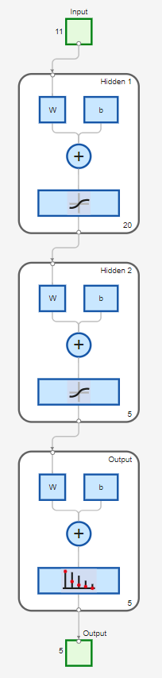
BUILDING & TEST NETWORK DIAGRAM
'imput/
features’
'weights’
'bias’
'sum’
'softmax’

Slide 18
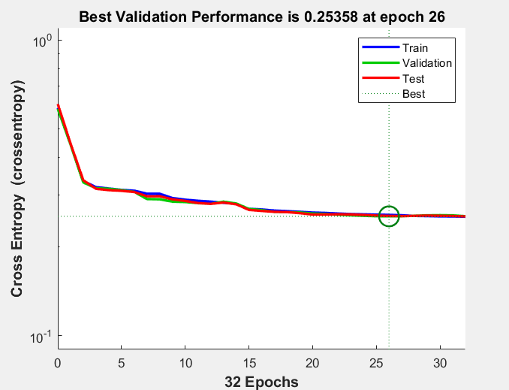
BUILDING & TEST PERFORMERS
If the validation loss starts increasing and the training loss stops improving, training should be stopped to avoid overfitting.

Slide 19
BUILDING & TEST TRAINING STATE
Learning diagnostics
High gradients, mu not decreasing
End of training session when validation is increased

Slide 20
BUILDING & TEST CONFUSION MATRIXS

Slide 21
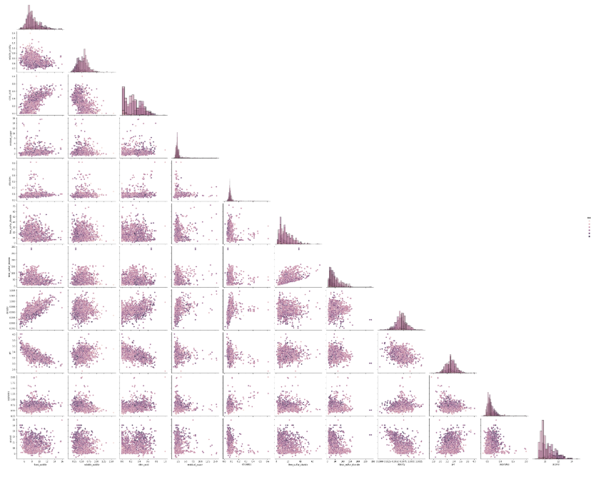
BUILDING & TEST HISTOGRAM
other developers use the PAIRPLOT, which gives more data on the histogram

Slide 22
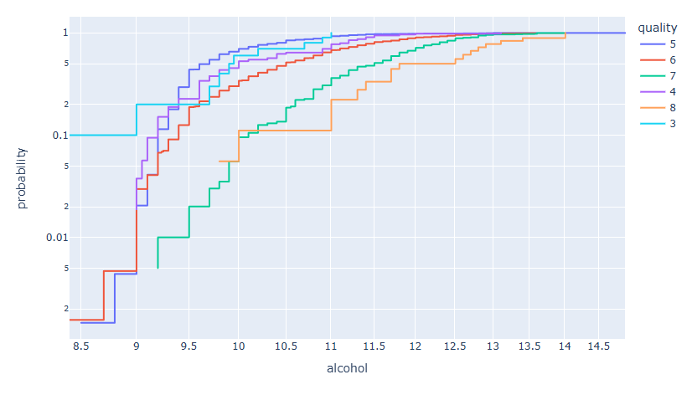
TRAINING PROCESS: RECEIVER OPERATING CHARACTERISTIC
Class 1 shows the best performance in the ROC curve. For higher classes, the curves move closer to the diagonal, which indicates weaker classification performance for those classes.
GRAPH FROM 🍷 Red Wine Quality

Slide 23
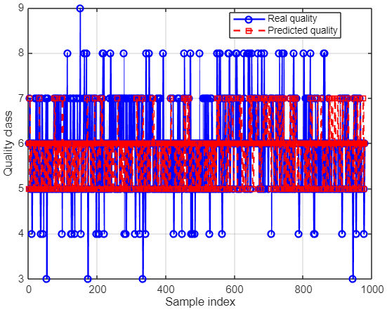
RESULT PLOT & GRAPH for 3:9 classes
OBSERVATION: NETWORK TRYED TO PUT ALL THE SAMPLES IN CLASS 6
RESULT: NETWORK IGNORED 3,4,8 and 9
classes!!

Slide 24
RESULT Reduced class to 4:8, averaging of samples
precision = diag(cm)./sum(cm,2) + eps;
cv = cvpartition(Y_cat,'Holdout',0.2);
NaN
Value Count Percent
1 732 8.41%
2 2331 26.77%
3 3517 40.39%
4 1408 16.17%
5 720 8.27%
Value Count Percent
1 586 15.63%
2 926 24.69%
3 958 25.55%
4 704 18.77%
5 576 15.36%
WORSE RESULT?

Slide 25
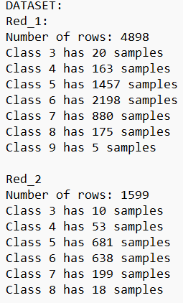
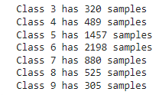



BUILDING & TEST CODING: try to used different method
Only used 2 different dataset:
Classes 3 and 9 removed, Set of 160 samples for each class
CALCULATION:
Sub database_Raw + Red_2:
?
Accuracy of network 49-53%
Undersampling class 5,6
Suggestion
Defined Class Weights
data operations were
performed using python
Oversampling clas 3,9
Accuracy of network ~50%

Slide 26
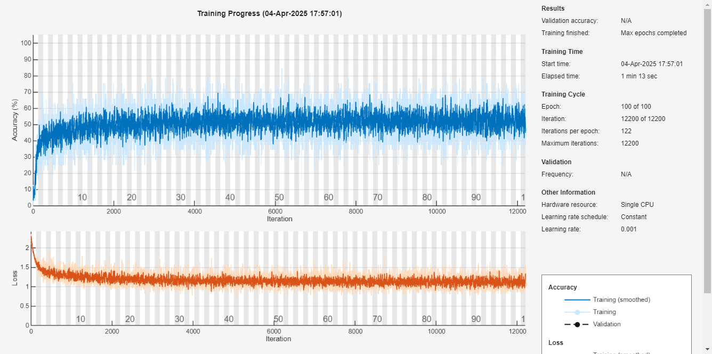
BUILDING & TEST CODING: try to used different method
SMOTE function does not help == same result as before
Accuracy of network steal ~50%

Slide 27
PRESENTATION 3

Slide 28
PROJECT GOAL
MATLAB Toolbox:
Statistics and Machine Learning & Deep Learning
EXCEL Dataset
NUMERICAL DATASET:
BUILD MULTILAYER-PERCEPTRON:
CHECK IMPORTANT FEATURES:
…

Slide 29
If the points on the PCA graph overlap, it means that the method does not distinguish well between classes and is not suitable for effective recognition.
Here, the difficulty in distinguishing
between features 5,6,7
FINAL CONFUSION MATRIX:
PCA – EXTRACTION FEATURES:

Slide 30

All tasks have been completed.
Milestone
Presentation 1 (25.03.2025) Topic - Wine quality classification using ANN.
(8.04.2025/6.05.2025) Prepare code to next presentation.
Presentation 2 (20.05.2025) Multilayer prescription, function, back propagation etc.
(20.05.2-25/3.06.2025) Preprocessing set Test/Train/Validation.
Presentation 3 (17.06.2025) Project - Solution. + GUI app designer

Slide 31
Surprises in Matlab:
Some functions don’t display their variables in the Workspace.
The flexibility of the network architecture allows using a greater number of neurons in the hidden layers: net = patternnet([128 64 32 8]);
The Threshold Designer tool allows selecting the most important features to use in the model.
Using the Deep Learning Toolbox, the designer doesn’t have to access or manage many variables manually.
MATLAB is faster in calculations and matrix operations.

Slide 32
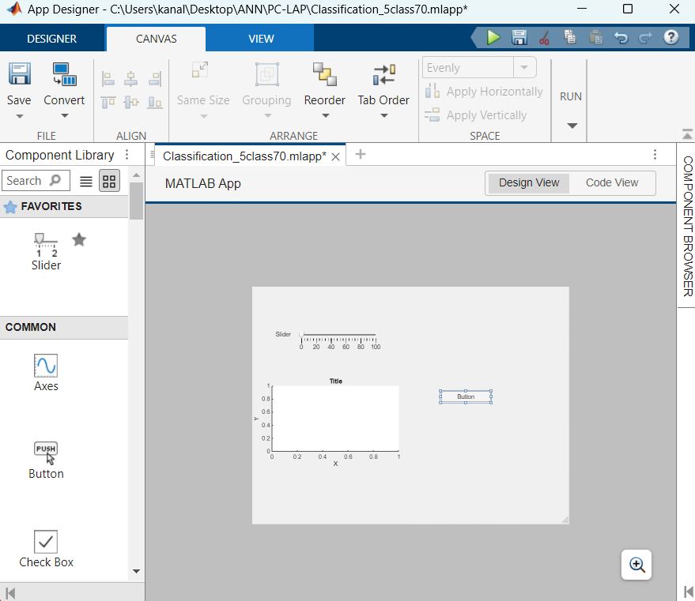
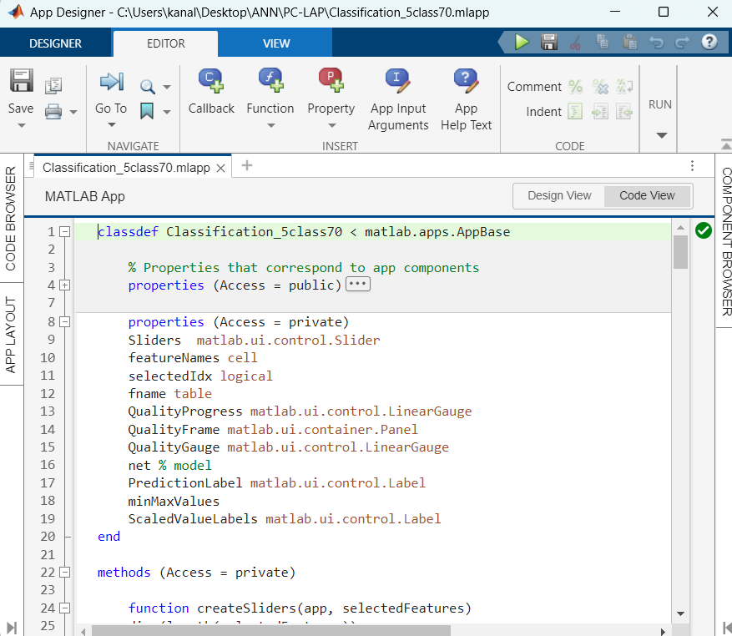
GUI APPDESIGNER
DESIGN VIEW: MANUAL
CODE VIEW: RED DATA FROM MATLAB

Slide 33
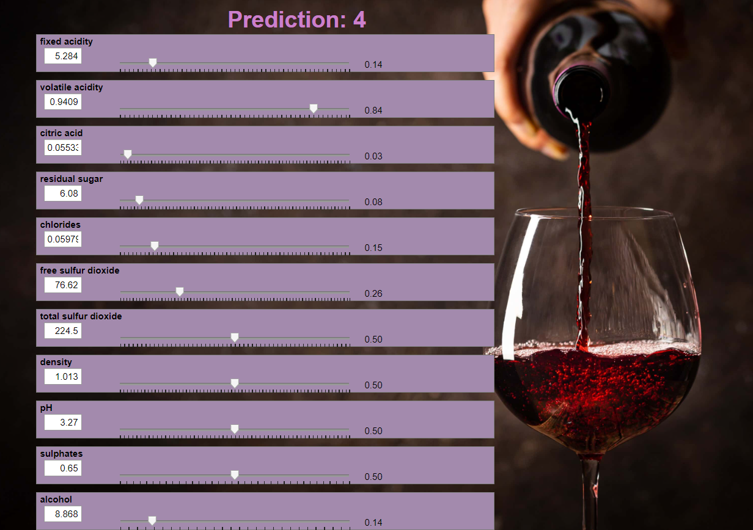
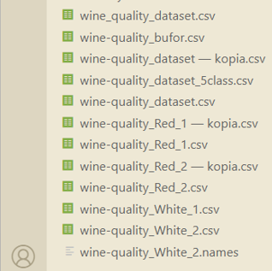
GUI APPDESIGNER
EXCEL Dataset
Samples can be
compared manually
using the model.

Slide 34
Was the neural network the best solution?
MLP (Multilayer Perceptron) network can work well for simple or moderately complex classification tasks.
The data are highly non-linear or exhibit temporal and spatial structures (e.g., images, audio, text).
MLP does not use local dependencies like CNNs or temporal dependencies like RNN/LSTM.

Slide 35
Upgrade „Wine quality classification using Artificial Neural Network„ Project:
Predicting wine price using regression models.
Classifying wine type (e.g., white vs. red) separately.
Adding origin information (region or country) for classification or analysis.
Including additional indicators like acidity or sugar levels for better insights.
Creating market segmentation or personalized wine recommendations.
Implementing multitask learning to predict quality, type, and price simultaneously
Next different Project „Trajectory Stabilization System for an Electric Motorcycle”
Goal: Develop a control system that keeps the electric motorcycle on a stable path
by correcting deviations in real-time.
Key Components:
Motion sensors (e.g., MPU6050 gyro + accelerometer) to measure tilt and acceleration
Motor controller (ESC) to adjust speed and torque
Control algorithm (PID or adaptive controller) for trajectory correction
Navigation system (GPS or other sensors) to track position and heading
User interface for monitoring and parameter tuning
Possible Extensions:
Obstacle detection and automatic path correction
Machine learning to optimize control under various conditions
Remote monitoring and control via a mobile app

Slide 36
END

